Slide 1
TO THE BANKING WORLD
Welcome

Slide 2
Major Project on Credit Risk Analytics (BonDora Bank)
BY Members of Team F
Internship Program
Under the Guidance of:
EVOASTRA VENTURES

Slide 3
Participants Members of Team F
Dhananjay D. Nagare (TL)
Shibasis Karmakar (Co-TL)
Arati Y. Dange
Radha Gohil
Raghav Bhardwaj
Indrajeet
Mobashshir ALi
Nayash Sayyed
Suryansh Gupta
Yugasri
Dange Arati
Tejas Pawar
Nikhil Aswal

Slide 4
About the Case Study
The loan providing companies(like Bank or other financial Institutions) find it hard to give loans to the people due to their insufficient or non-existent credit history. Because of that, some consumers use it to their advantage by becoming a defaulter.
When the company receives a loan application, the company has to decide for loan approval based on the applicant’s profile. Two types of risks are associated with the bank’s decision: If the applicant is likely to repay the loan, then not approving the loan results in a loss of business to the company If the applicant is not likely to repay the loan, i.e. he/she is likely to default, then approving the loan may lead to a financial loss for the company.

Slide 5
Data Set Explanation
Previous Application Data
Application Data
1048576 numbers of Rows
38 numbers of Columns
307512 numbers of Rows
122 numbers of Columns
After Cleaning & taking important data
Previous Application New Data
Application New Data
664066 numbers of Rows
9 numbers of Columns
276480 numbers of Rows
13 numbers of Columns

Slide 6
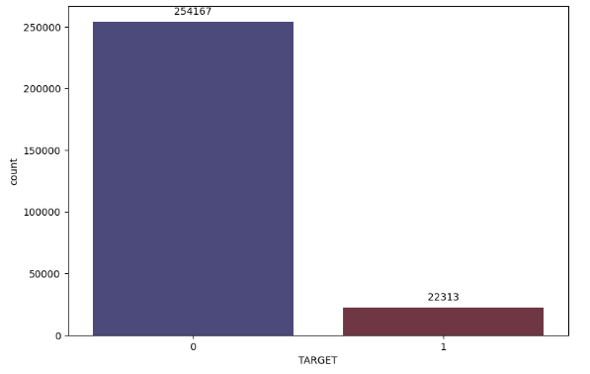
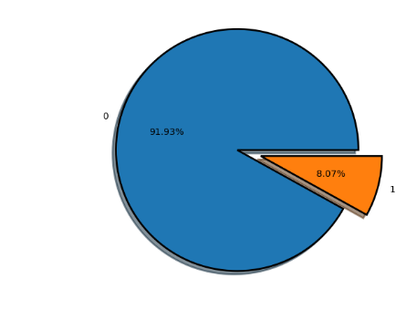
Target Variable
1 as representing a loan that defaulted
and
0 as a loan that was successfully approved and repaid.

Slide 7
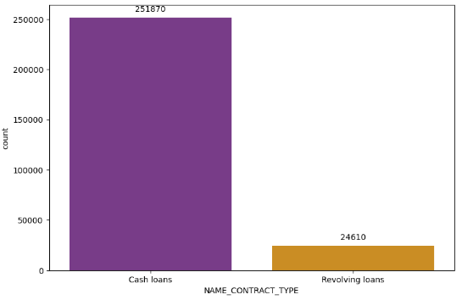
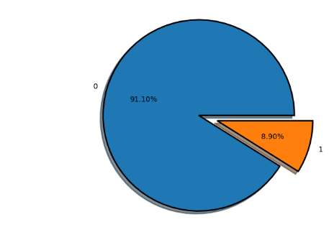
Identification of Loan
Cash loan
Revolving loan
A cash loan is a loan which is received by the borrower in cash.
This sets it apart from overdraft loans, installment loans and leases.
Cash loans may be given to a private individual as a personal loan or
to a business as a business loan.
A revolving credit facility is a type of credit that does not have a fixed number of payments.
It allows you to use a line of credit up to a specified limit. This means you can repeatedly
access the credit as long as you do not exceed the set credit limit and continue making timely
payments. A Credit Card is an example of a financial instrument that offers a revolving credit.

Slide 8
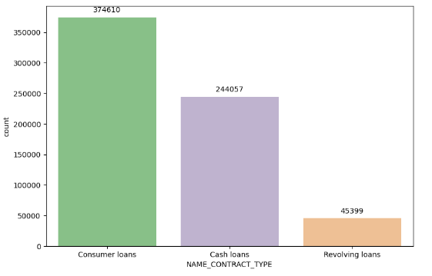
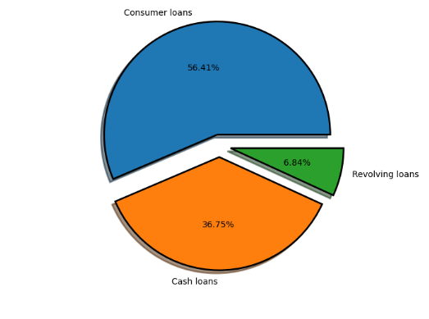
Identification of Loan on Previous application
Consumer loan
Cash loan
Revolving loan
A cash loan is a loan which is received by the borrower in cash.
This sets it apart from overdraft loans, installment loans and leases.
Cash loans may be given to a private individual as a personal loan or
to a business as a business loan.
A Consumer Loan is a loan that banks offer to customers to buy household goods and appliances and even personal devices. These include television sets, air-conditioners, home theatre systems, refrigerators, laptops, mobile phones, cameras and even modular kitchens.
A revolving credit facility is a type of credit that does not have a fixed number of payments.
It allows you to use a line of credit up to a specified limit. This means you can repeatedly
access the credit as long as you do not exceed the set credit limit and continue making timely
payments. A Credit Card is an example of a financial instrument that offers a revolving credit.

Slide 9
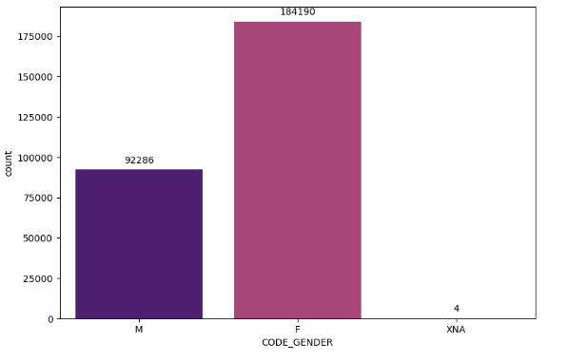
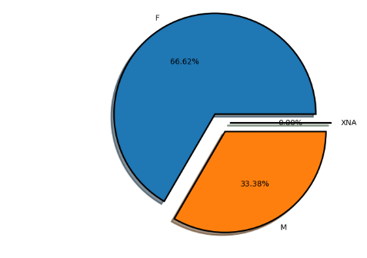
Types of Gender
3 types of gender are there : Male , Female and Transgender

Slide 10
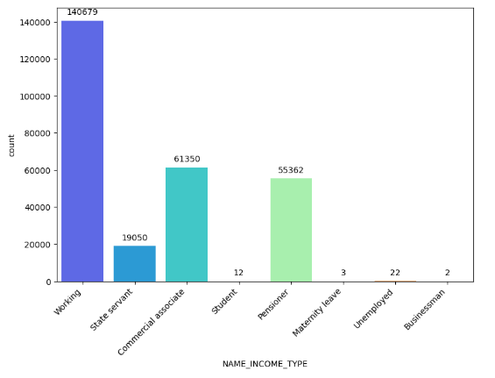
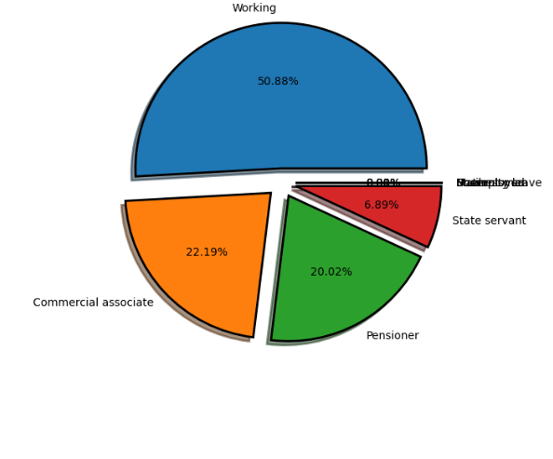
Income Type
Source of income is vital component in terms of getting Loan from Bank. Here we can see 8 types of income.

Slide 11
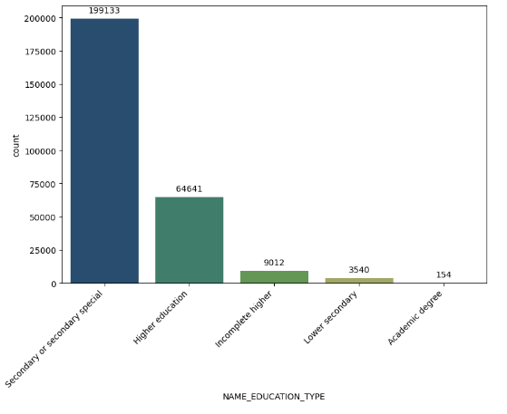
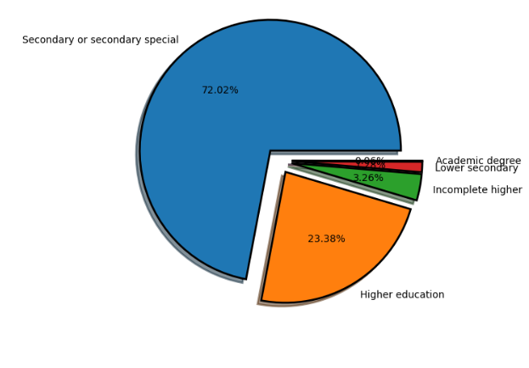
Education Achieved
Qualification achieved by the Client or consumer of the bank.

Slide 12
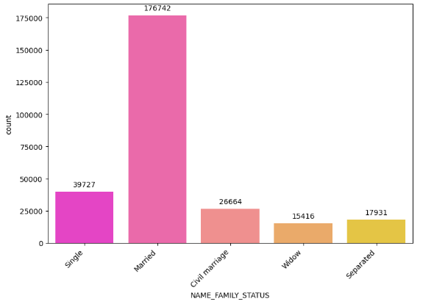
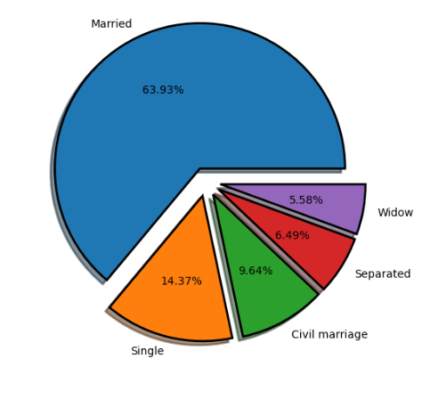
Civil Status of client
In terms of loan provided by the bank, civil status or marital status can impact the mortgage eligibility & interest rate in India.

Slide 13
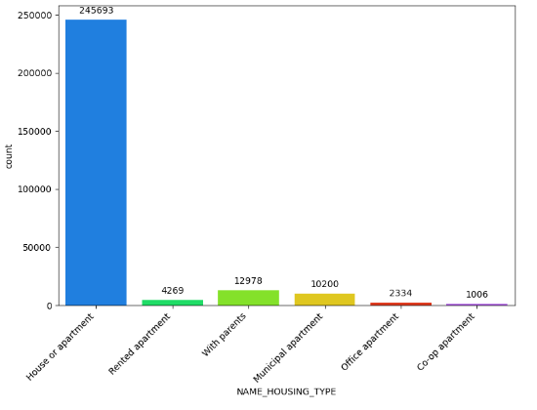
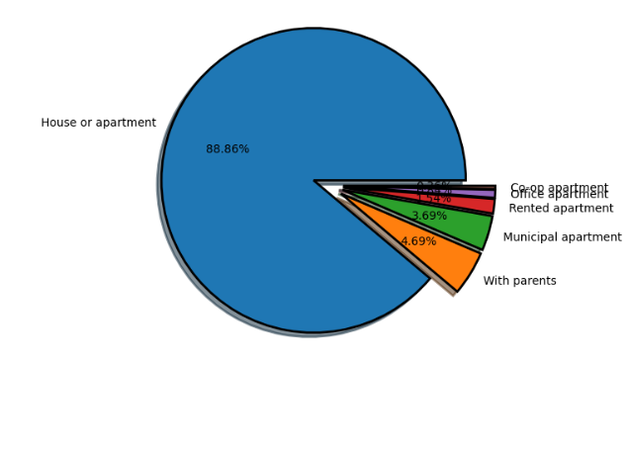
Property type
Property type is much more important in terms of getting loan. Mortgage loan is one of the example of bank loan.

Slide 14
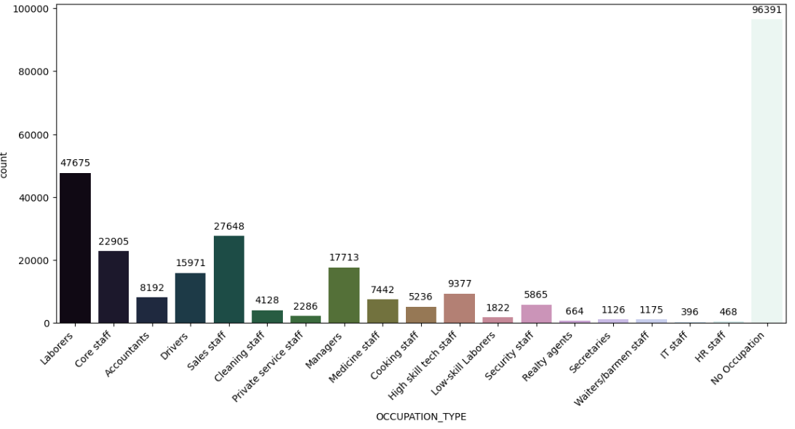
Occupation type
Source of income is much more vital in repaying & getting the loan from any financial institutions.

Slide 15
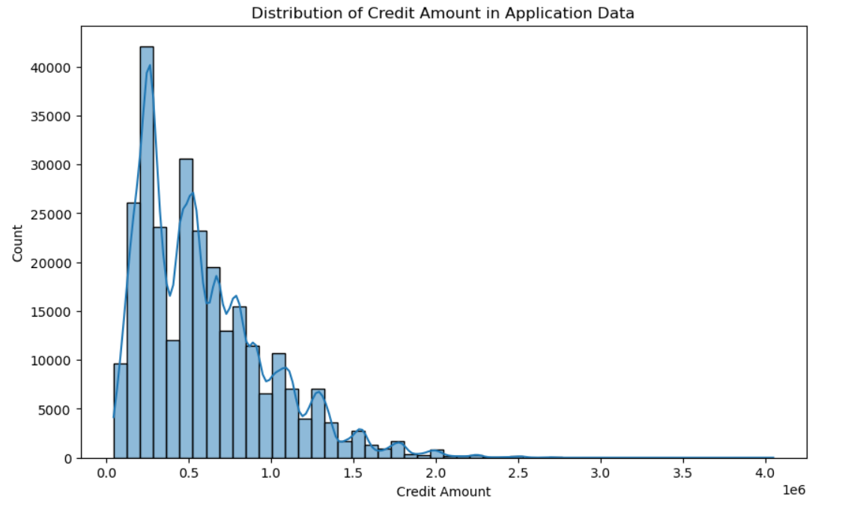
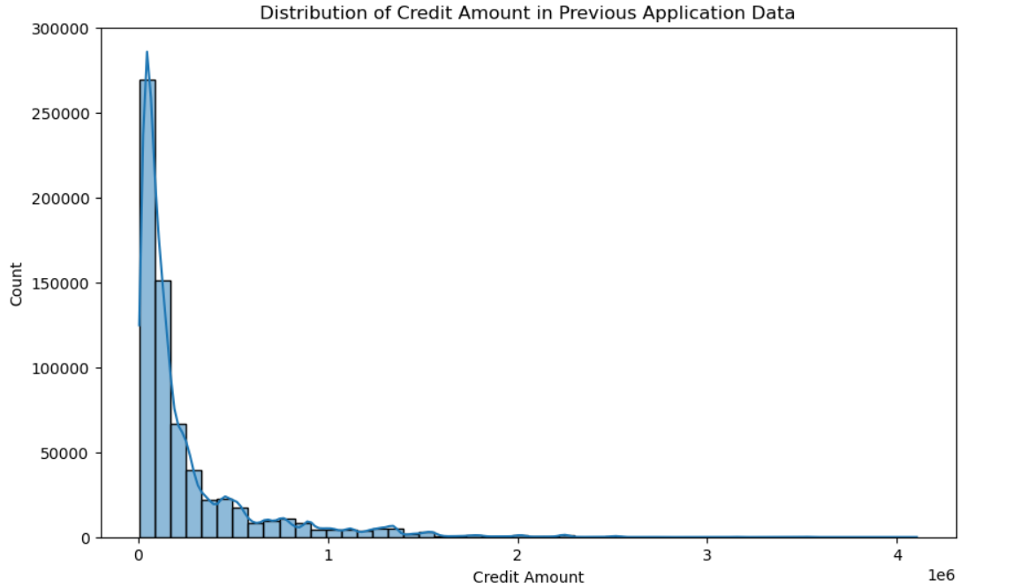
Credit Amount
The bank credit is the total amount of money that a person or business can borrow from a bank.
Here in the data point we can see that Average Credit amount is 5lakhs 92 thousands in Application data where as in previous application data is 2lakhs 46 thousands.

Slide 16
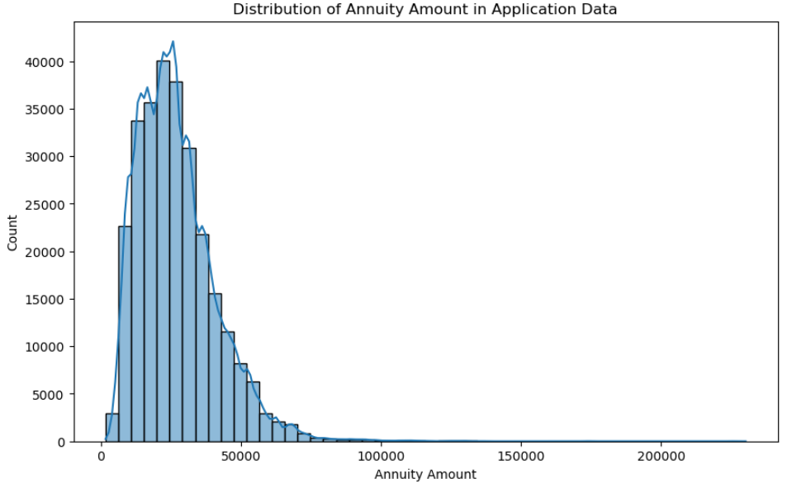
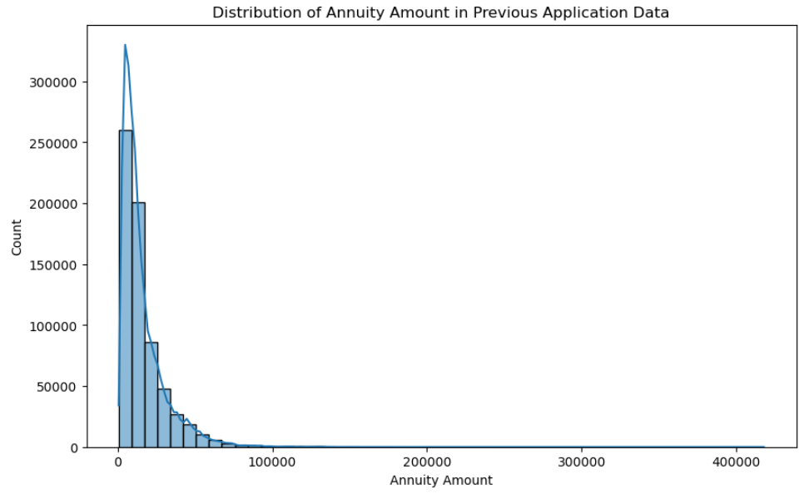
Annuity amount
a person pays either a lump sum amount or regular instalments in the given period to get regular payments or payouts as long as he/she lives or for a pre-specified fixed period.
As per data Set of the both current & previous Application it suggest that average annuity amount is 26 thousands & 15 thousands respectively.

Slide 17
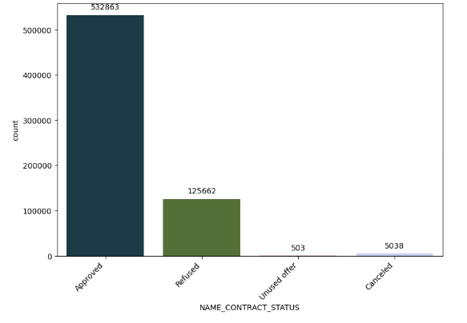
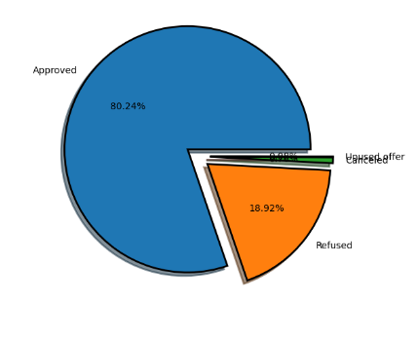
Application status on previous data
As per the previous data , Application status has an impactful occurrence in terms of providing Credit to the Client.

Slide 18
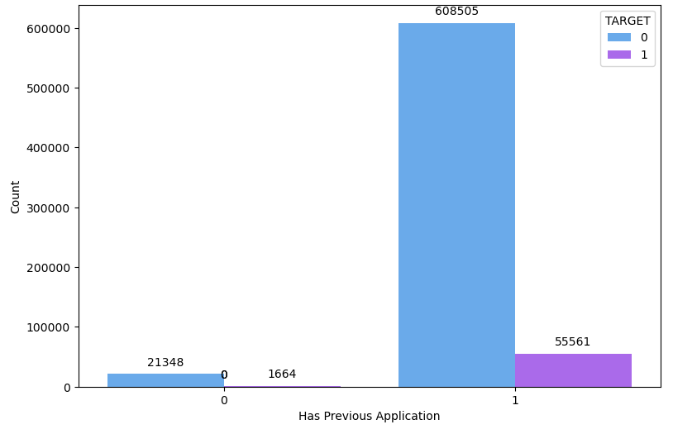
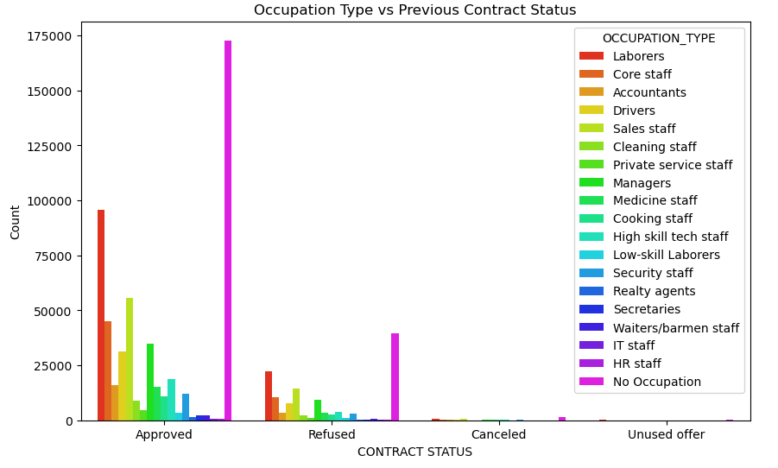
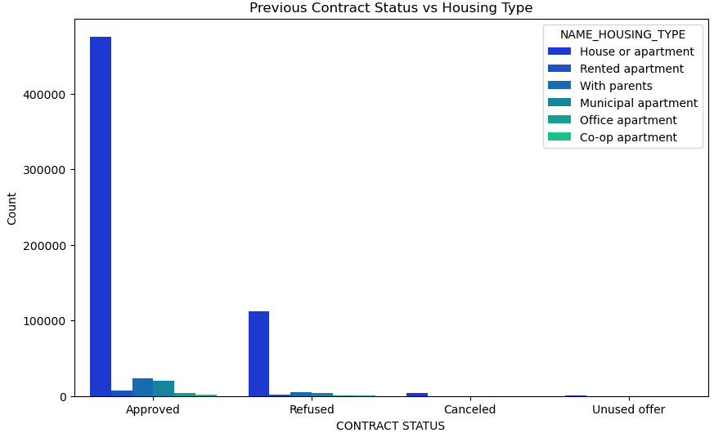
Relationship between two data Set
The 1st plot shows that the client who are previously also applied for the loan and they considered as the defaulters & non defaulters.
2nd plot showcase that according to the occupation of the client , previously those client has been considered .
3rd plot indicate the housing type according to the previous data .

Slide 19
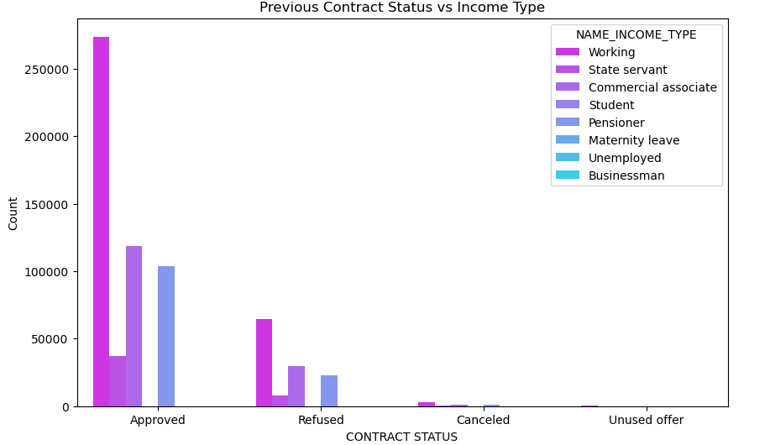
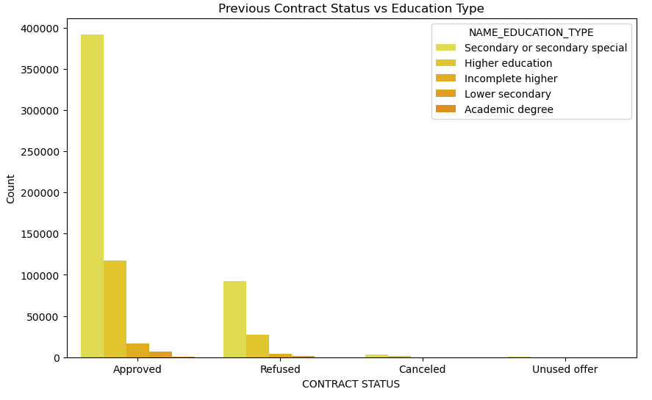
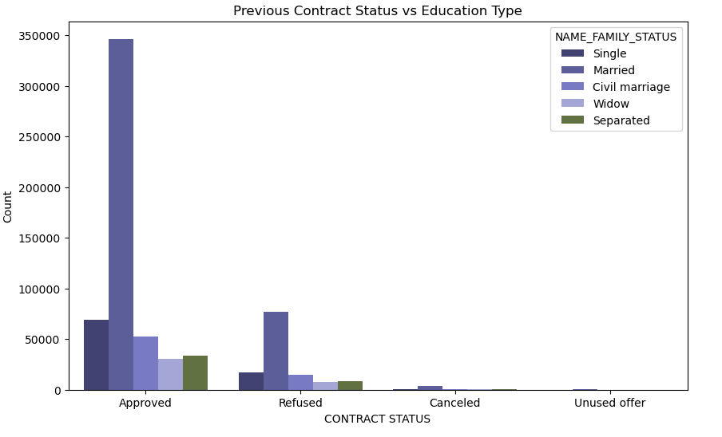
Relationship between two data Set
According the 1st plot indicate the Income type in respect to contract status.
In the 2nd plot ,education type showcase with contract status.
Last plot shows the marital status of a client in terms of contract status.

Slide 20
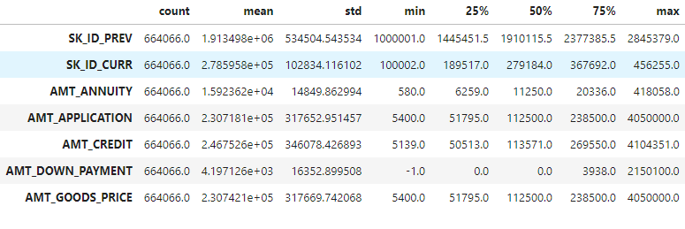
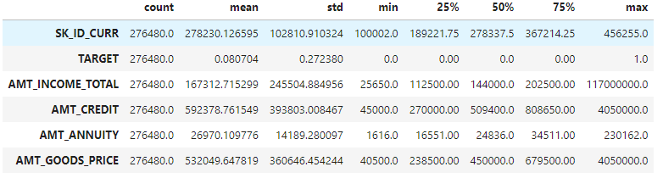
Descriptive Statistic
According to the Previous application data,
Highest Application amount is 40lakhs 50 thousands & minimum is 5 thousands 4 hundreds.
maximum Amount credit to their account is 41lakhs 4 thousands & minimum is 5 thousands.
4 lakhs 18 thousands is the highest annuity amount & the lowest annuity amount is 5 hundreds.
The maximum price of the good s is 40lakhs 50 thousands & minimum is 5 thousands 4hundreds.
According to the application data,
Highest income of client is 11corers 70 lakhs & minimum income is 25 thousands six fifty.
maximum Amount credit to their account is 40lakhs 50 thousands & minimum is 45 thousands.
2 lakhs 30 thousands is the highest annuity amount & the lowest annuity amount is 16 hundreds.
The maximum price of the good s is 40lakhs 50 thousands & minimum is 45 thousands.

Slide 21
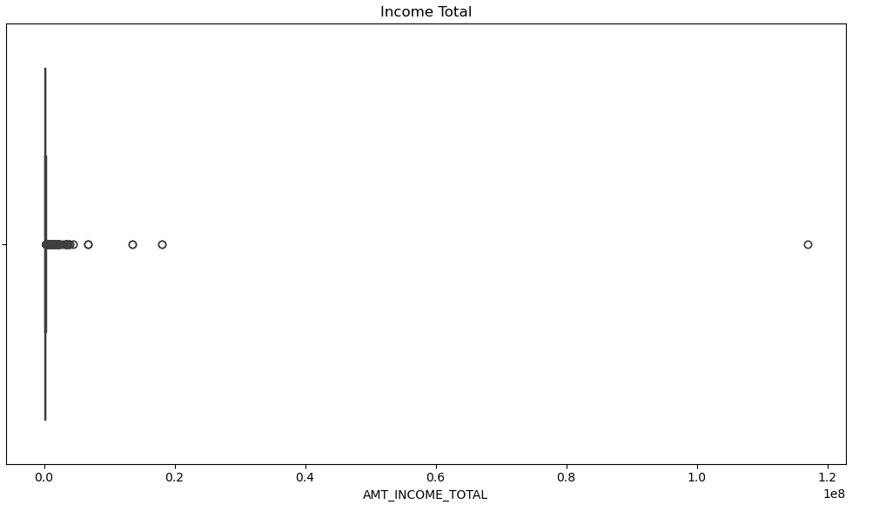
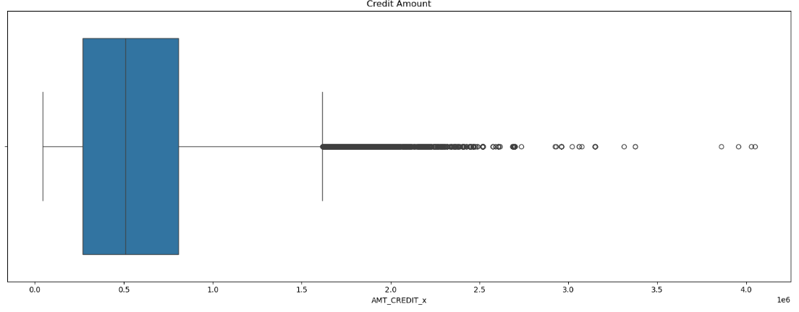
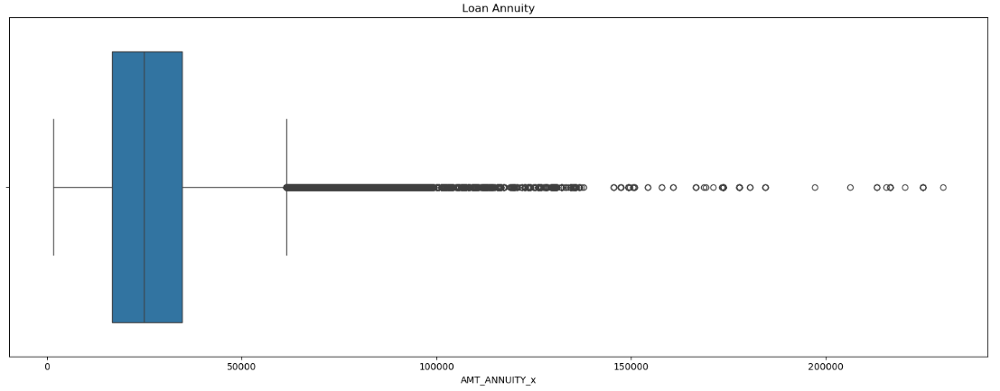
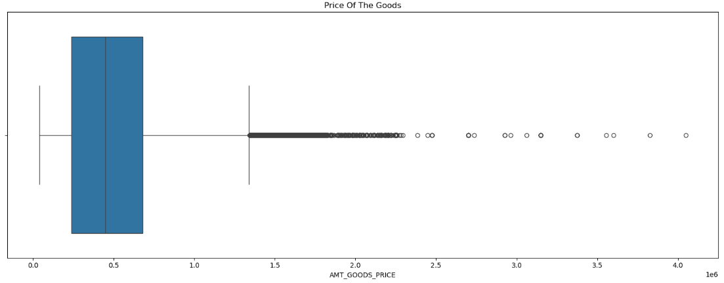
Outlier Detection
As per the data point we can observe that all features has the Outliers.

Slide 22
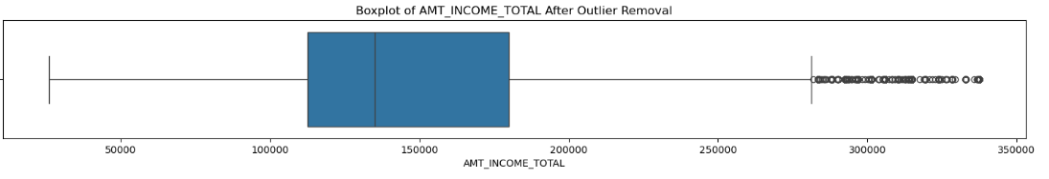
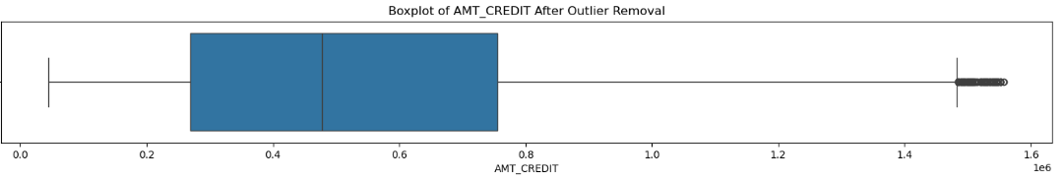
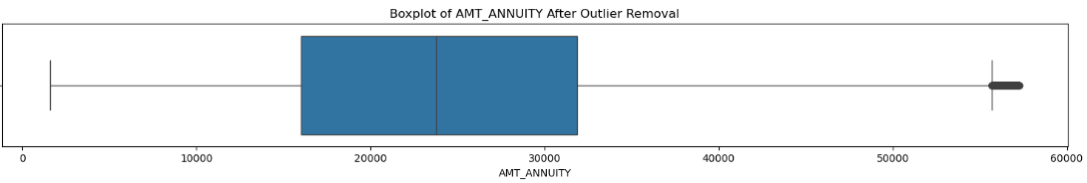
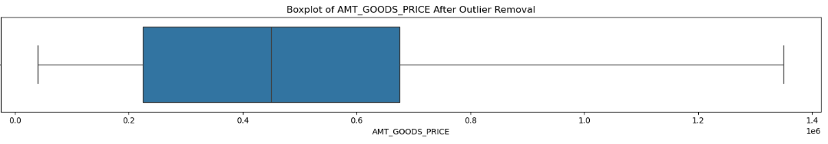
After removal of Outlier
After using IQR method we can see there was reduction in the Outliers

Slide 23
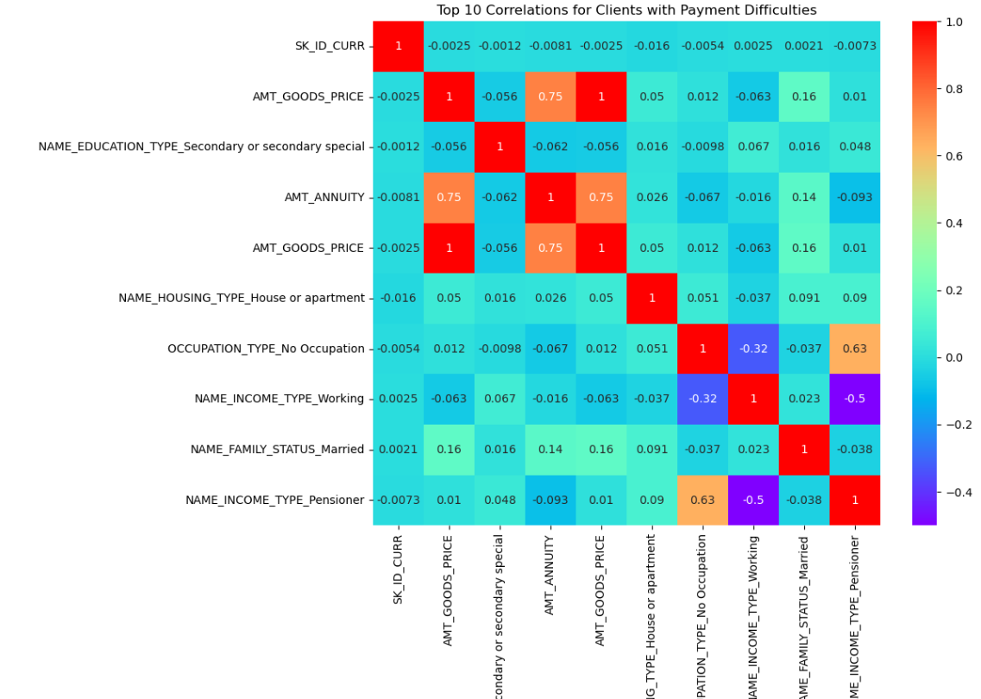
Correlation for Client
There was a positive correlation between
Goods price & Annuity
Occupation & Income type(pensioner)
There was a negative correlation as well
EDUCATION & Annuity
Education & goods price

Slide 24
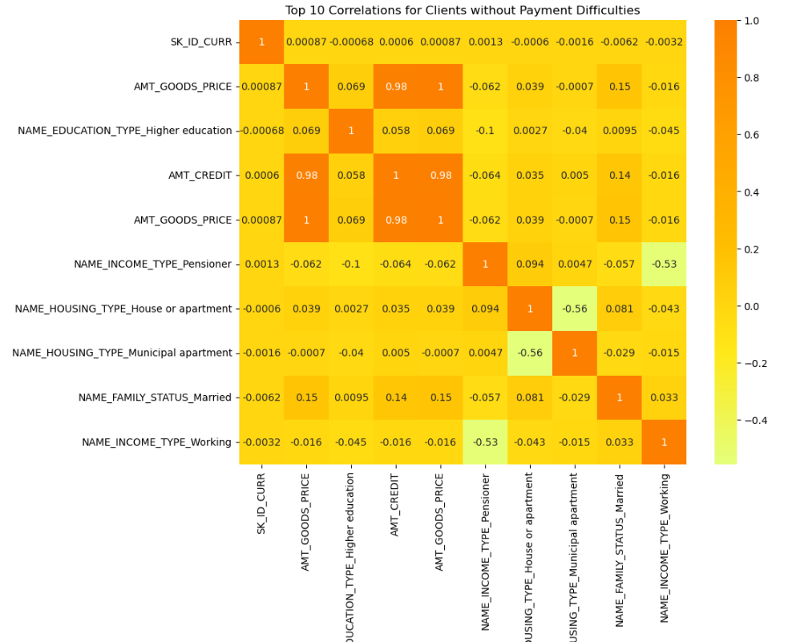
Correlation for Client
There was a positive correlation between
Goods price & Credit amount
Goods price & Education
There was a negative correlation as well
Housing type ( house or apartment & Municipal apartment)
Income Type ( Working & Pensioner)

Slide 25
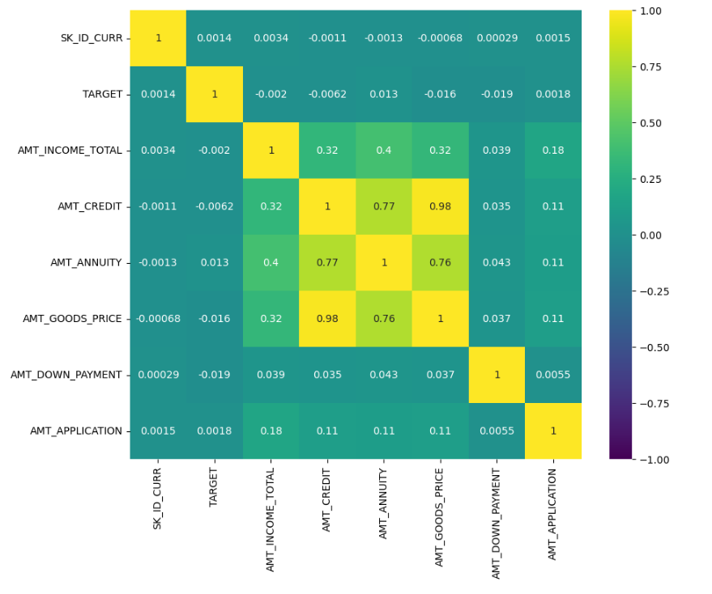
Correlation on Merge data
There was a positive correlation between
Goods price & Credit amount
Credit amount & annuity amount
Goods price & Annuity Amount

Slide 26
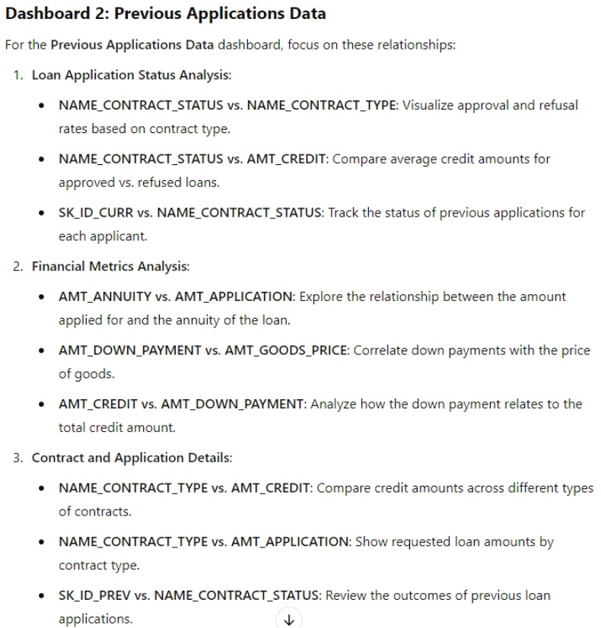
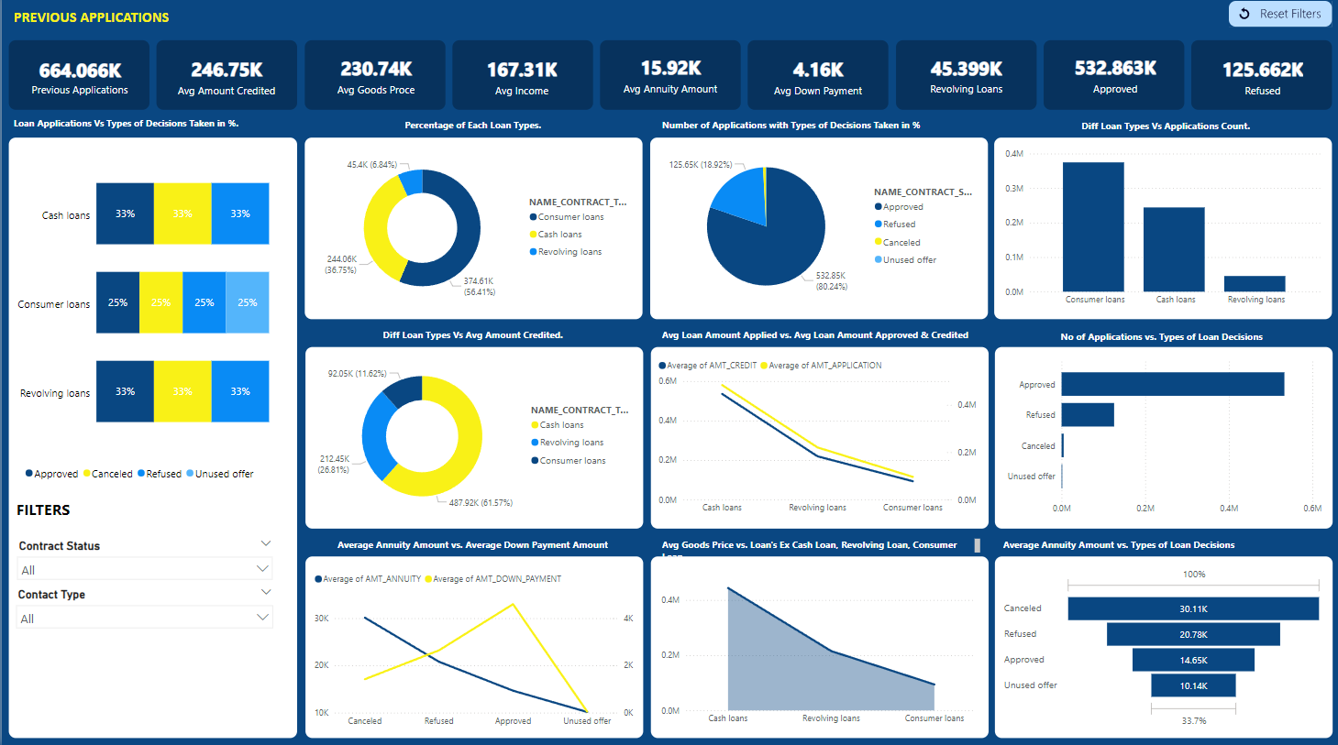
Dashboard on Previous data

Slide 27
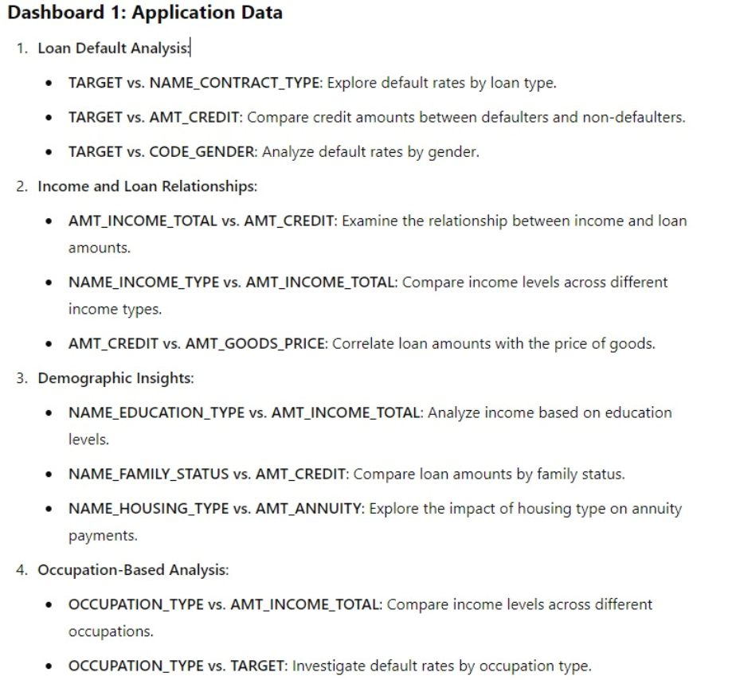
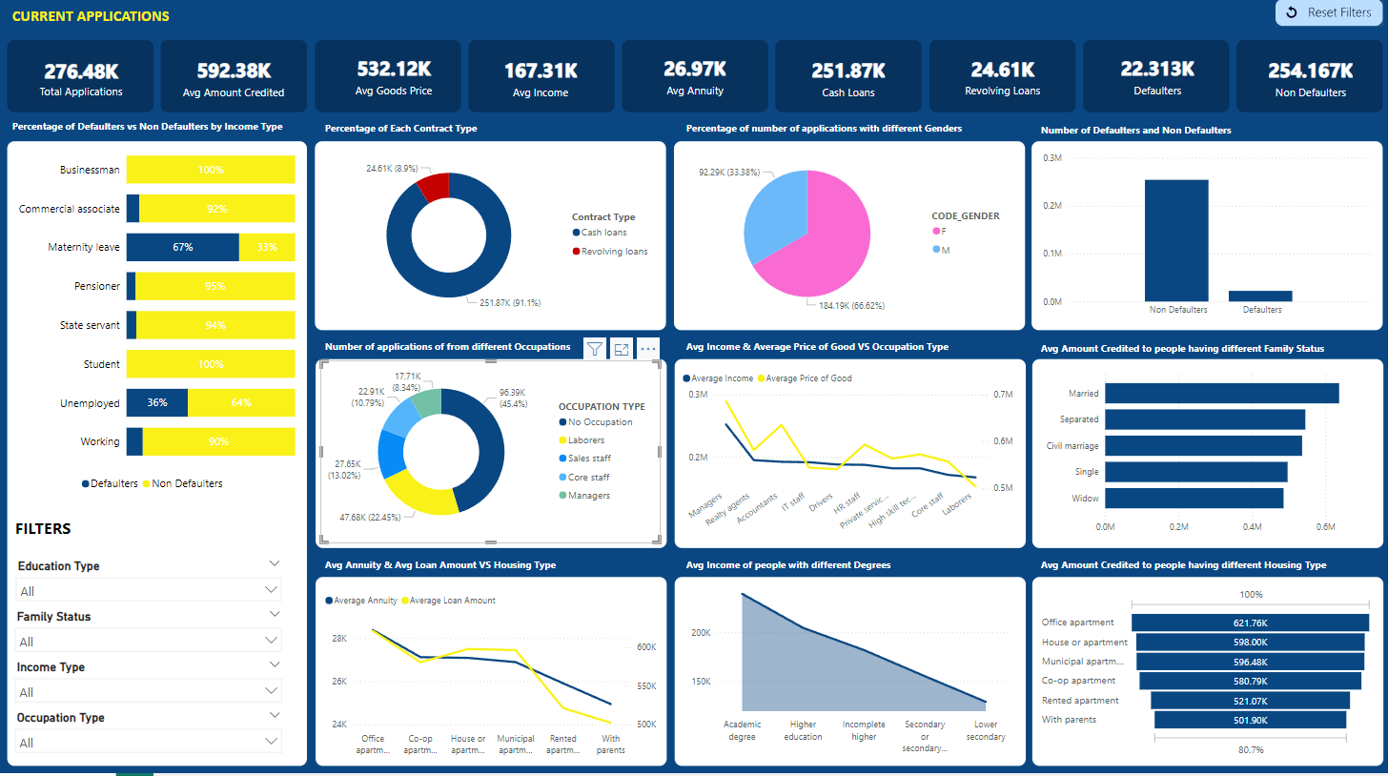
Dashboard on Application data

Slide 28
TO All the team Members
Thank you

